Slide 1
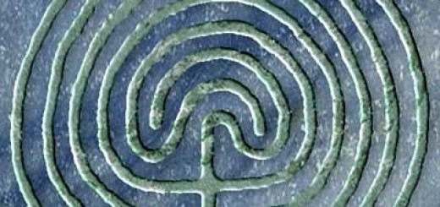
Hermeneutics and Qualitative Research
Transpersonal Research Colloquium (TRC) 2016 United Kingdom

Slide 2
Professor Emerita, Rosemarie Anderson, Ph.D.
Sofia University, Palo Alto, CA USA
rosemarie.anderson@sofia.edu
www.rosemarie.anderson.com

Slide 3
Hermeneutics? What is it?
Etymologically, from “Hermes,” Greek God of Communication
Art of Interpretation, Communication, & Translation
Origins within all religious & wisdom traditions with sacred texts
For oral traditions, interpretation is immediate

Slide 4
“Classical” European Hermeneutics
Friedrich Schleiermacher (Germany, 1768-1834): Intuitive Exegesis
Hans-Georg Gadamer (Germany, 1900-2002): Dialogical Imperative
Alfred North Whitehead (UK/USA, 1861-1947): Participatory Impulse to see the world as a web of interrelated processes or “events”

Slide 5
Friedrich Schleiermacher (Germany, 1768-1834)
Pastor, Chaplain, Theologian
Deeply passionate
Soul as “Force”
“…immediate intuition or feeling of God.”
Translator of Plato’s Republic

Slide 6
Schleiermacher’s Intuitive Exegesis
Hermeneutics: “hypothesis testing” between meaning & grammar and interpreter’s intuition & imagination (Hermeneutic Circle)
Paradox of Translation involves 2 choices:
Leave author the in peace & move the reader toward the author (Cycle 4, Intuitive Inquiry, that is, participant quotes)
or
2. Leave the reader in peace & move the author toward the reader (Cycle 5, Intuitive Inquiry, researcher’s conclusions)

Slide 7
Hans-Georg Gadamer (Germany, 1900-2002)
Professor of Philosophy, Univ. of Marburg, Leipzip, Frankfurt, & Heidelberg
Student of Martin Heidegger
Truth and Method (1960)

Slide 8
Gadamer’s Dialogical Imperative
Structure of Plato’s dialogues as “key” to his hermeneutic circle
Entering into dialogue with text beings both the text and the reader into question – and changes both (central to Intuitive Inquiry)
PLAY as central to dialogue and hermeneutics (central to Intuitive Inquiry)

Slide 9
Alfred North Whitehead (UK/USA, 1861-1947)
Professor of Mathematics & Philosophy (Cambridge, Univ. College London, Harvard)
Principia Mathematics with Bertrand Russell (1910)
Process and Reality (1929)

Slide 10
Whitehead’s Participatory Impulse
“Everything flows” -- Heraclitus of Ephesus, born ca. 560 BC
All of life is a process of becoming– not just dialogic but participatory & interdependent
“…Things of … the world” are “drops of experience, complex, and interdependent”
For hermeneutics & research is ACTION, that is, performative
The Sacred is a verb.

Slide 13
Professor Emerita, Rosemarie Anderson, Ph.D.
rosemarie.anderson@sofia.edu
www.rosemarie.anderson.com

